Slide 1

Project – Brain War
Lecturer
Rokas Slaboševičius
Data

Slide 2
Today you will learn
Project - Brain War
Project - Brain War
01

Slide 3
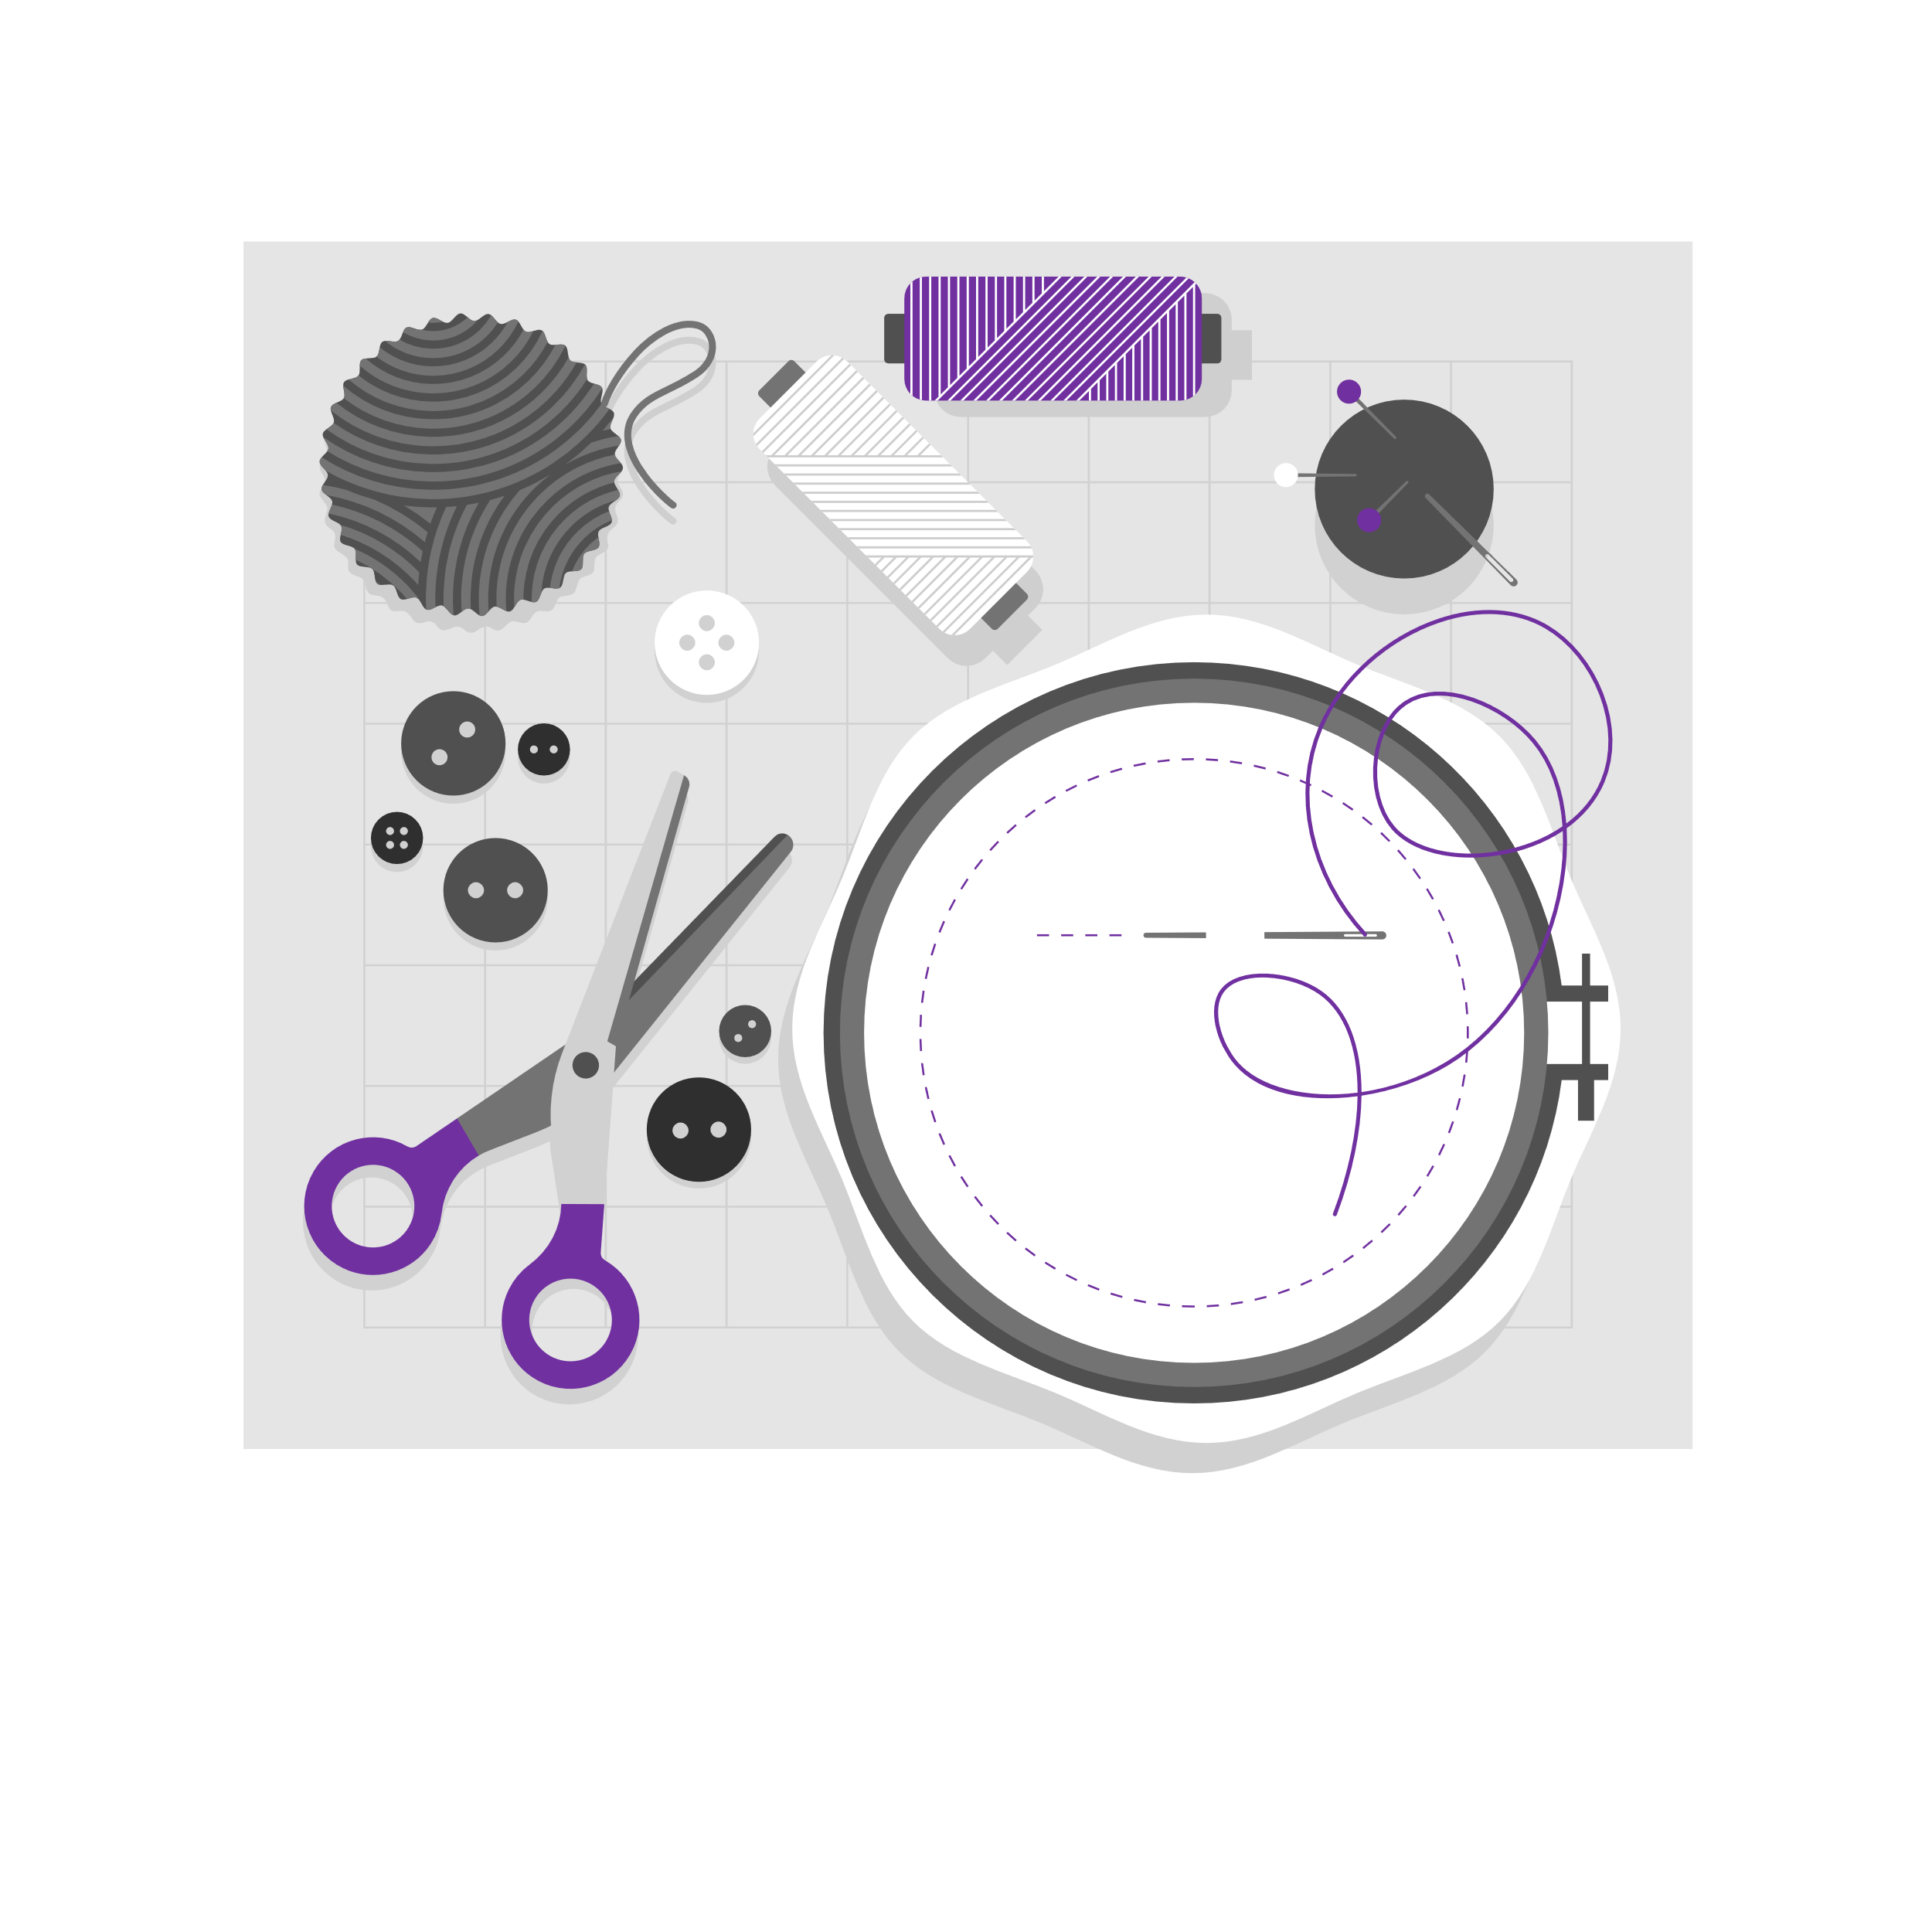


Project - Brain War
Project - Brain War
You have been commissioned to program a digital Brain War app.
Time: Two lessons for work, one lesson for presentation.
The aim of this exercise will help you to revisit what you have already learned and give you the right context to apply it to a bigger project.
Following the requirements and functionality descriptions, you will have to design and present your project.

Slide 4

Project - Brain War
Project No 1
The project is designed to warm up your skills for your final thesis. It will help you to understand what it feels like to develop a larger programme where both you and your teacher will have the opportunity to see where your strengths lie and where your skills could be improved (2-3 lessons)
Create an application that allows you to log in using your first and last name. Once logged in, we would be able to solve quiz problems on a variety of topics. The app should allow users to see the results. When doing the project, do not hesitate to consult and correspond with both teachers and groups, but do not copy identical code from each other, try to write it yourself.
Facilitation:
If you feel that the tasks are very complex, you can change the condition to "create a game for 1 player only". This way you will only need to collect results for one player and the logins can be static data.

Slide 5
Project - Brain War
Project No 1
Functionality:
Log in to
Logout
Representation of the game rules
Review of game results and participants
Participation (Start game)
Exit the game

Slide 6
Project - Brain War
Project No 1
Windows
Window 1(Login): when you start the app, the app should greet you and ask you to log in. The first window should only ask for a first and last name. Nothing else is displayed.
Window 2(Menu): after logging in, the application should greet you when you log in and display the menu items (See list of functionality)
Window 3(Option): when one of the menu items is selected, the application should display what belongs to that menu option on the screen accordingly (See detailed requirements for menu items). The "q" input should bring us back to the menu.

Slide 7
Project - Brain War
Project No 1
Log in:
In the login window, you should be able to enter your name. After entering the name, our user should be registered as a new record. Recommendation to use Dictionary when storing users (We assume that there will not be a second identical first and last name). If we enter the name of an existing user, the program should warn us that we are currently using the account of an existing user. If it is a new account, the application should congratulate us on logging in and creating a new account.
When you have successfully logged in, it should bring up the menu items on the screen. During the application, remember to keep the currently connected user somewhere so that you know who is playing at the moment. For the active user you can create a new variable "CurrentUser" which will help your application to identify it during functions. At the top of the console, in all but the login window, we should see which user we are currently logged in with. When styling, you can use the Console.Clear() method to clear the window after the options and re-render everything.

Slide 8
Project - Brain War
Project No 1
Disconnection:
The application should display that a logout has been performed and ask the user to enter their name to log back in.

Slide 9
Project - Brain War
Project No 1
Representation of the game rules:
The software should display the rules of the game. For example, you can take "Congratulations on joining the X Challenge app. This challenge allows you to choose from X categories of questions. Once you have selected a category, you will start the game and you will have to choose which is the correct answer to your question from 4 possible options."
The program should ask the user to enter the letter "q" if they want to go back to the menu options

Slide 10
Project - Brain War
Project No 1
Review of game results and participants
Selecting this menu item should display an additional menu. Inside this menu we would have the option to choose whether we want to view participants or results. If we select participants then all current participants should be displayed. If we choose to view the results it should bring up all users in descending order of the number of points scored. The TOP10 should have the number of positions and the TOP3 should have an asterisk "*" at the end of their name depending on their position, e.g.: 1st place 1 star etc. Use the .Sort method.
Recommendation for additional conditions: if you are working with multiple question categories and decide to keep separate Highscores for multiple question categories you can use Dictionary<string, Dictionary<string, int>>. In this case, your list will hold the points for each name in each category. AccountDictionary<FirstName, CategoryDictionary<CategoryName, Tasks>>

Slide 11
Project - Brain War
Project No 1
Participation (Start game):
Depending on whether you are working with multiple categories, the software should output the category options. If you are working with a single category, the game should start and the first question should be output to the user. How many questions there should be per session is up to you. At the top of the console it should say how many questions there are at the moment e.g. 1/10. The user should know the result of the question as soon as they confirm their answer by writing their answer choice e.g. "1. Answer 1". The application should write how many points the user currently has. The application should ask the user questions until it reaches the number of questions you set for the session. When all the questions have been answered, it should display the user's results on the screen: which questions have been answered correctly, which have not. It should also display the final points scored and the position of this session among the highest scorers. The letter "q" should send the user back to the menu. As a guideline for questions you can use List<T> or Dictionary<T,K>.

Slide 12
Project - Brain War
Project No 1
Exit the game:
The app should close.

Slide 13
Project - Brain War
Project No 1
Additional (Only do this if you have already done the basic functionality of the challenge)
Make the questions randomly selected from the possible questions
Add multi-category options
Insert a hall help which should help you with the Random class to "tentatively" determine which answer is correct (This can be done by typing "s" and pressing "enter")
Insert help to rule out 2 incorrect options (This can be done by typing "d" and pressing "enter")
Make different questions worth different amounts of points depending on their complexity

Slide 14
Project - Brain War
Project No 1
Additional (Only do this if you have already done the basic functionality of the challenge)
Extend the app so that when the app chooses what questions to ask the user, it chooses based on how often the question is answered correctly. For example, if you have question 5 which is answered by 100% of users and you have question 18 which is answered by only 10% of users, the program should give priority to question 18.
Insert an administrator login that has access to the additional menu option "Configurations". In this window you can select how many questions users should receive per session. Consider how the scoring weighting should be arranged when such a change is made, because if there were 10 questions before and now there are 15, then a person answering 10/10 would be counted as having answered less than 14/15.
Add a timer and create time limits for questions (Google helps)

Slide 15
Project - Brain War
https://learn.microsoft.com/en-us/dotnet/api/system.console?view=net-7.0
https://learn.microsoft.com/en-us/dotnet/api/system.collections.generic.dictionary-2?view=net-7.0
https://learn.microsoft.com/en-us/dotnet/csharp/language-reference/statements/iteration-statements
https://learn.microsoft.com/en-us/dotnet/api/system.collections.generic.list-1?view=net-7.0
Useful information

